Slide 1
Clustering
Techniques for grouping similar objects into clusters. “A cluster is a collection of records that are similar to one another and dissimilar to records in other clusters.”
Clustering techniques are unsupervised because we don’t determine, in advance, the labels to apply to the clusters. The structure of the data determines how best to group the objects.

Slide 2

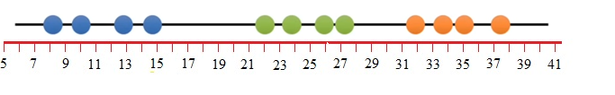
K-Means Clustering (not to be confused with k-NN)
This can be done with n-dimensional data. We’ll start with n = 1. Below we have data on a single variable:
7.6, 9.5, 12.5, 14.4, 22.0, 23.8, 26.0, 27.3, 32.1, 34.0, 35.4, 37.9
By eye, this looks as if we should make 3 clusters:

Slide 3


Steps to K-Means Clustering
Step 1: Select the number of clusters, k.
Start with k = 3. We want to identify 3 clusters. (Later: How to determine a good choice for k.)
Step 2: Randomly select 3 distinct data points; these are the initial guesses for the cluster centroids.
Points selected: 9.5, 14.4, 26.0.
Step 3: Measure the distance between the 1st point and the three initial cluster centroids.
Distance between 1st point, 7.6, and blue cluster: 1.9
Distance between 1st point and green cluster: 6.8
Distance between 1st point and yellow cluster:18.4
Step 4: Assign points to nearest cluster.
First point is assigned to blue cluster.

Slide 4
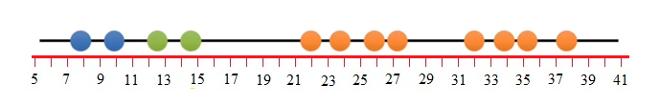
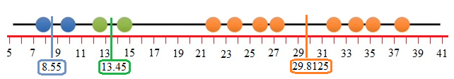
Continue Assigning Points to Clusters
Assign 2nd point, 9.5, to blue cluster
Consider 3rd point, 12.5:
Distance from blue cluster: 12.5 – 9.5 = 3.0
Distance from green cluster: 14.4 – 12.5 = 1.9
Distance from orange cluster: 26.0 – 9.5 = 13.5
Assign 3rd point to green cluster.
7.6, 9.5, 12.5, 14.4, 22.0, 23.8, 26.0, 27.3, 32.1, 34.0, 35.4, 37.9
Step 5: Calculate the mean of each cluster.
Blue cluster mean: 8.55
Green cluster mean: 13.45
Orange cluster mean: 29.8125

Slide 5
Second Iteration: repeat steps 3 - 5
Repeat the process in Steps 3 – 5 (measure and cluster) using the means as the centroid.
For the second iteration, the clustering did not change from the initial clustering. So, we are done.
The k-means clustering did a terrible job compared to what we did by eye. How do we know that it did a bad job?
We assess the quality of the clustering by adding up the variation within each cluster: Within Sum of Squares, WWS
Blue cluster: (7.6 – 8.55)² + (9.5 – 8.55)²
Green cluster: (12.5 – 13.45)² + (14.4 – 13.45)²
Orange cluster: (22.0 – 29.8125)² + (23.8 – 29.8125)² + . . . + (37.9 – 29.8125)²
Sum to get WSS = 241.0388

Slide 6

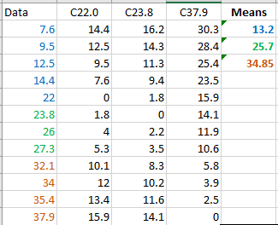
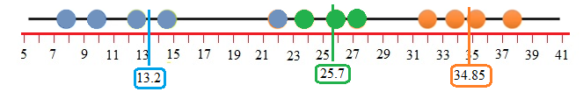
Repeat the process: initial iteration
We keep track of the last cluster and its WSS. Then we start again by randomly selecting 3 initial cluster centroids from the data.
Step 2: Random points: 22.0, 23.8,37.9
Steps 3 - 5: Find distances between data points and centroids. Classify data into the clusters based on the smallest distance. Find the means of the data values in each cluster.

Slide 7
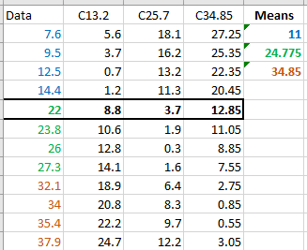
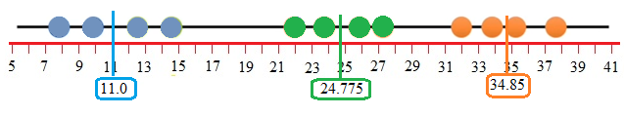
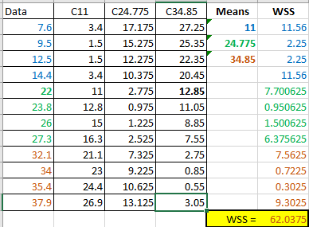
Repeat the process: 2nd iteration
No change.
Stop.
Calculate WSS.
Better compared
to WWS = 241.

Slide 8
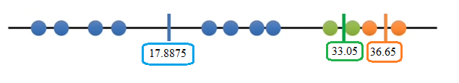
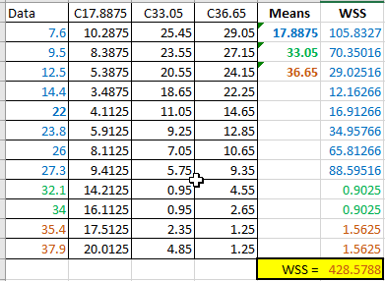
Repeat the process 3rd time -- Competing against WSS: 241 and 63
Here’s the last stage of 3rd try where clusters did not change.
Repeat again; k-means does as many repeats
as you tell it. So far, k-means knows
2nd is the best overall.

Slide 9
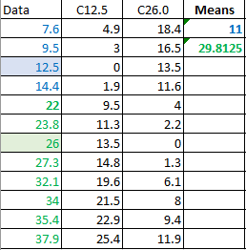
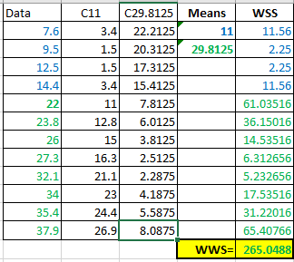
How do you figure out what k to use?
What if we try a different value for k?
Start with k = 1. This is the worst case since every data point is together in one cluster. WSS = 1208.809 (Variance * 11).
Next try k = 2.
Note: k = 3
did better.

Slide 10
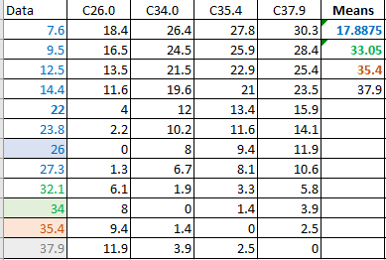
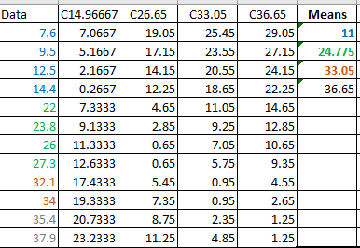
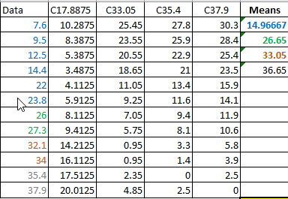
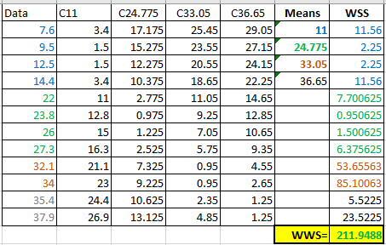
Keep going, try k = 4

Slide 11
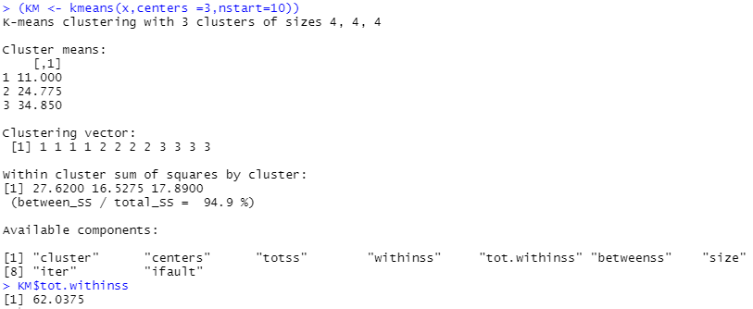


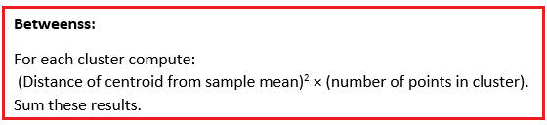
Turning to R

Slide 12


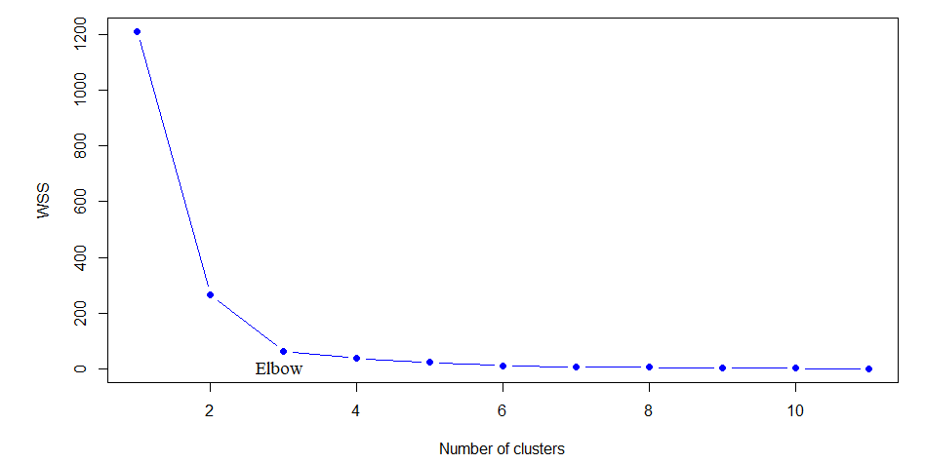
Choosing a value for k
Choose k = 3

Slide 13
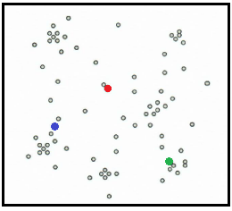
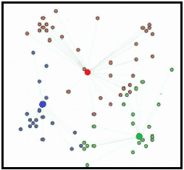
Higher dimensional data
Two-dimensional data
K-means is highly scale dependent. Not suitable for data of varying shapes and densities.

Slide 14
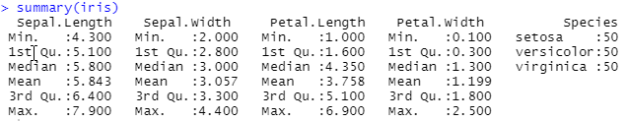
Return to iris data (4-dimensional features)
Can’t have missing values in data
Remove species variable; standardize data
ir <- iris[,-5]
irscale<-scale(ir)

Slide 15
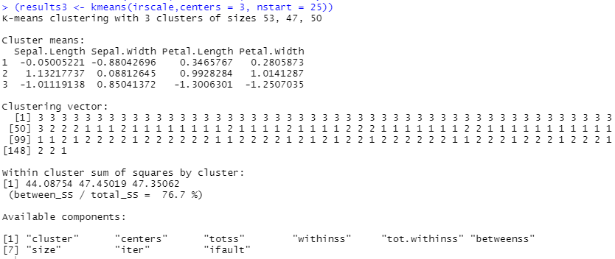
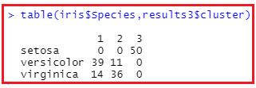
Continuing with iris data; k = 3

Slide 16
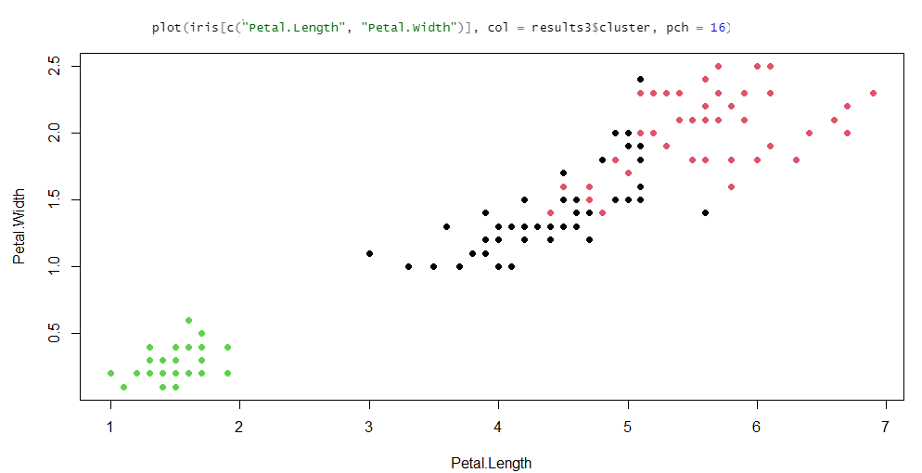
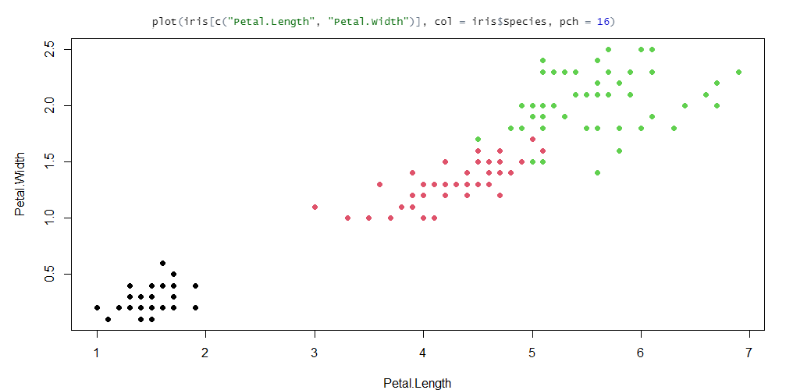

Slide 17
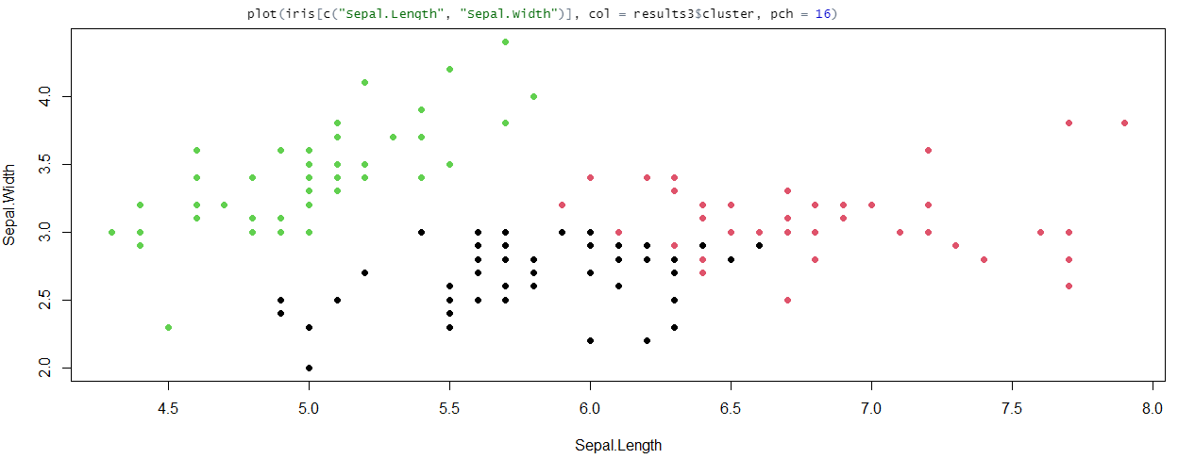
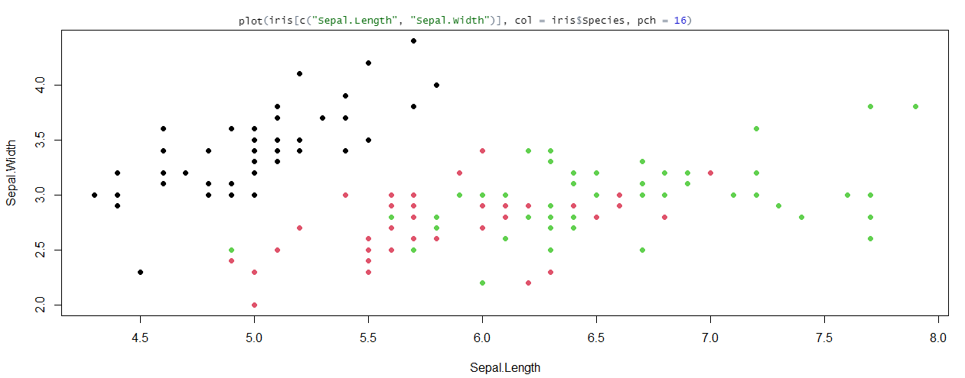

Slide 18
